Slide 1
Optimizing marketing campaign
A critical analysis
Shivani Agrawal

Slide 2

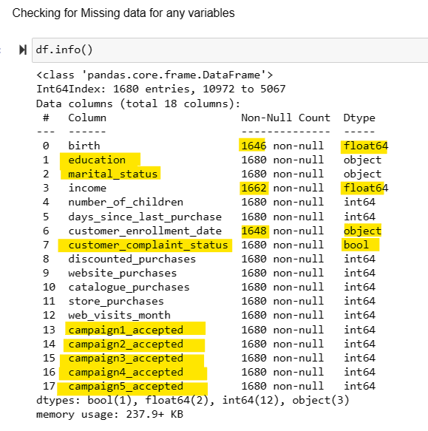
Part I: Data Understanding
Datatypes and missing variables:
We have missing data for 3 variables:
birth (birth_year) for 34 customers
income for 18 customers
customer_enrollment_date for 38 customers.
2. The data type of customer_complaint_status should be changed to bool as it states a yes or no answer.
3. The data type for the birth and income is float. An int type makes more sense.
4.The data type for customer_enrollment_date is a string, which should be modified to datetime.

Slide 3
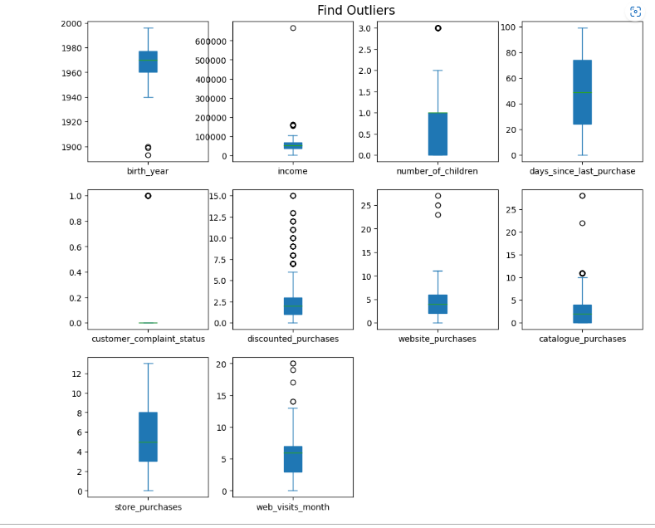
OUTLIERS
There are many columns having outliers, but most of them seem like natural outliers came from population.
The outliers in birth_year seems like entry errors since it's impossible that people who was born before 1900 still alive.
Therefore, I will remove the outliers in birth_year. There is one outlier in income with exceptionally high income> 600K$ and some >$100k. We will remove that customer considering such high income customers are not our target market.

Slide 4
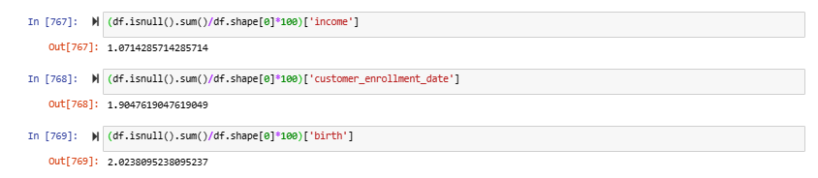
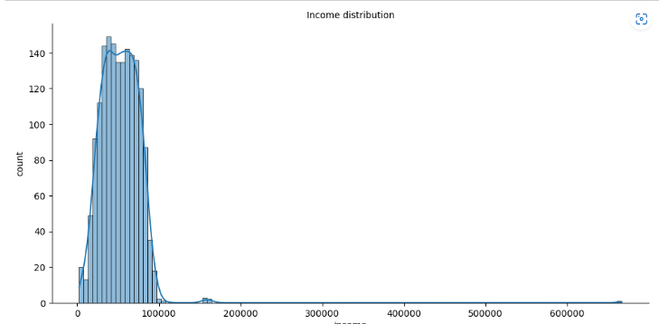
DEALING WITH MISSING VALUES
Extent of missing values: Income has ~1.07% missing values, customer_enrollment_date and birth has 2% of missing values (which is okay).
Observations:
After treating outliers, the distribution for the income variable is close to normal distribution with very few extreme observations to the right.
We have replaced the missing values for the income variable with the median, and not mean, as the variable was slightly skewed to the right.
Missing values for birth-year and customer enrollment date was also replaced by median.

Slide 5
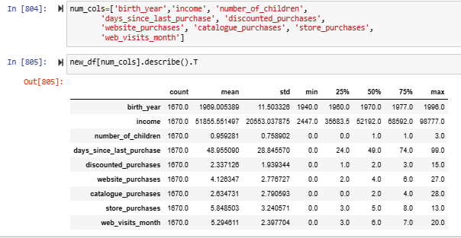
DESCRIPTIVE ANALYSIS – Numerical Values
Mean Income of customers is dollar 51855. Also lowest income a customer has is dollar 2447 and highest income a customer has is dollar 98777 (excluding the outliers). Also a typical customer has income of dollar 51381 yearly.
Average customer has 1 kid and maximum kids customers have is 3.
Average recency or days since last purchase is 48 and maximum number of days a customer has waited since last purchase is 99 and minimum is 0. 50% of people wait at least 49 days to make next purchase. 25% of the people wait at least 24 days to make a next purchase.
All the people are enrolled after 2012, and since then, average purchase by a customer from catalogue is 2, from store is 6 and from website is 4.

Slide 6
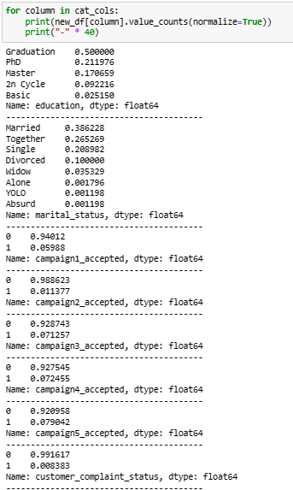
DESCRIPTIVE ANALYSIS – Categorical Valyes
In education, 2n cycle and Master means the same thing. We can combined these two categories.
There are many categories in marital status. We can combine the category 'Alone' with 'Single’.
It is not clear from the data that what do the terms 'Absurd', and 'YOLO' actually mean. We can combine these categories to make a new category - 'Others’.
There are only 13 customers who complained in the last two years. (1670 * 0.008383)

Slide 7
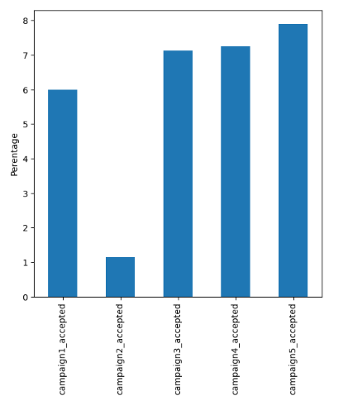
Observations on acceptance rate for each campaign
Observations:
Campaign 5 has the highest acceptance rate which is around 8%.
Campaigns 3,4 and 5 have a similar acceptance rate between 7-8%.

Slide 8
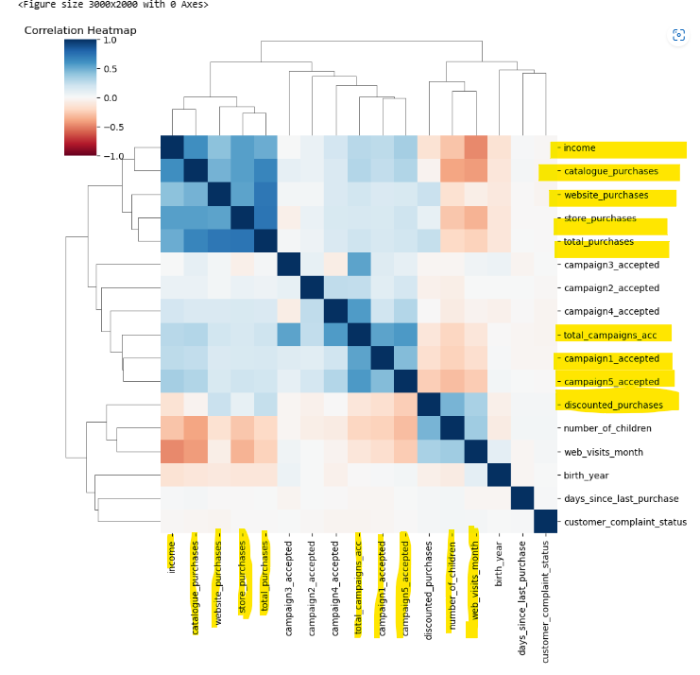
CORRELATION
Strong positive correlation between all kind of purchases and income
Strong positive correlation between campaign 1 and campaign 5
Positive correlation between number of children and website visits per month
Negative correlation between income and website visit per month, also between income and number of children

Slide 9
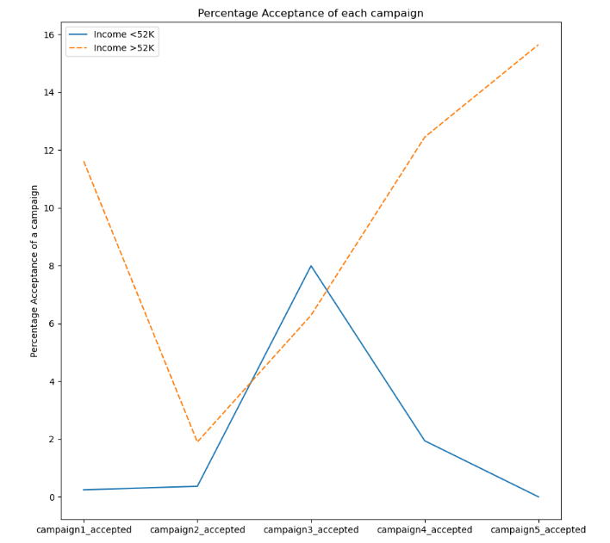
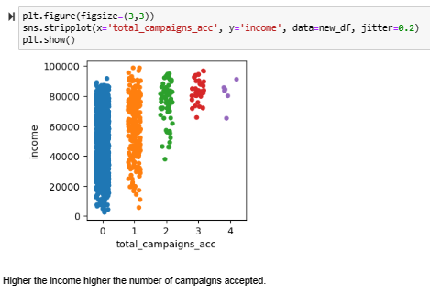
INCOME & TOTAL CAMPAIGN ACCEPTANCE
Observations:
As income rises, the more likely to accept multiple campaign
Observations:
Campaign 1, 4 and 5 are better suited to high income customers
Only Campaign 3 has similar acceptance rate for both categories.

Slide 10
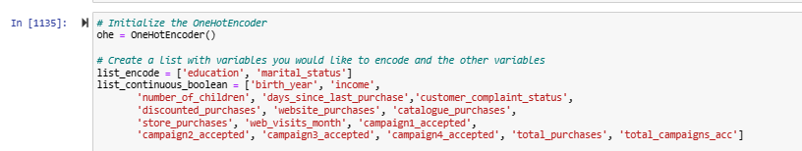
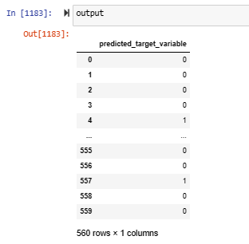
ONE HOT ENCODING

Slide 11
RECOMMENDATIONS
Keep using the same techniques as in 5th campaign as it has the highest conversion rate.
Have a loyalty program for high income customers > average as they are likely to convert
People with have a strong positive correlation with website visits. We might think promoting kids products on websites.
We must replicate campaign 3 if we have to focus on all the customers irrespective of income.
Revisit campaign 2 to understand what should be repeated
Very low customer complain, so keep customer services as is.
60% of our customers are married or couple, market couple oriented products

